Slide 1
HACK-A-CLOUD 2.0
TEAM NAME: Blue Pearl
PROJECT TITLE: Deploying a Containerized Docker Game on AWS Cloud
TEAM MEMBERS:
1) Varneth T - 312322205184 IT SJCE
2) Shyam Ganesh T - 312422104155 CSE SJIT
ECS EXPLORERS

Slide 2
PROBLEM STATEMENT
Deploying a containerized Docker game on AWS Cloud requires optimizing resources for cost-effectiveness, implementing robust security measures, and ensuring scalability for varying demands. Networking must be configured for secure communication, while monitoring and automation streamline operations. Backup strategies and cost management are essential, alongside compliance with regulations, and performance optimization for a seamless gaming experience.

Slide 3
ABSTRACT
The project aims to deploy a website contained within a GitHub repository using Docker and host it on AWS Elastic Beanstalk. The website files are fetched from the GitHub repository using curl within a Dockerfile. The Dockerfile configures an nginx server to serve the website on port 80. AWS Elastic Beanstalk is used to manage the deployment of the Docker container to AWS infrastructure.

Slide 4
PROPOSED SOLUTION
1.Containerization with Docker.
2. Configuration with Dockerfile.
3. Testing Locally.
4. Deployment to AWS Elastic Beanstalk.
5. Monitor game performance with CloudWatch alarms.
6. Benefit from Elastic BeanStalk scalability and IAM security features.
7. Achieve cost-effectiveness and automation with CloudFormation.

Slide 5
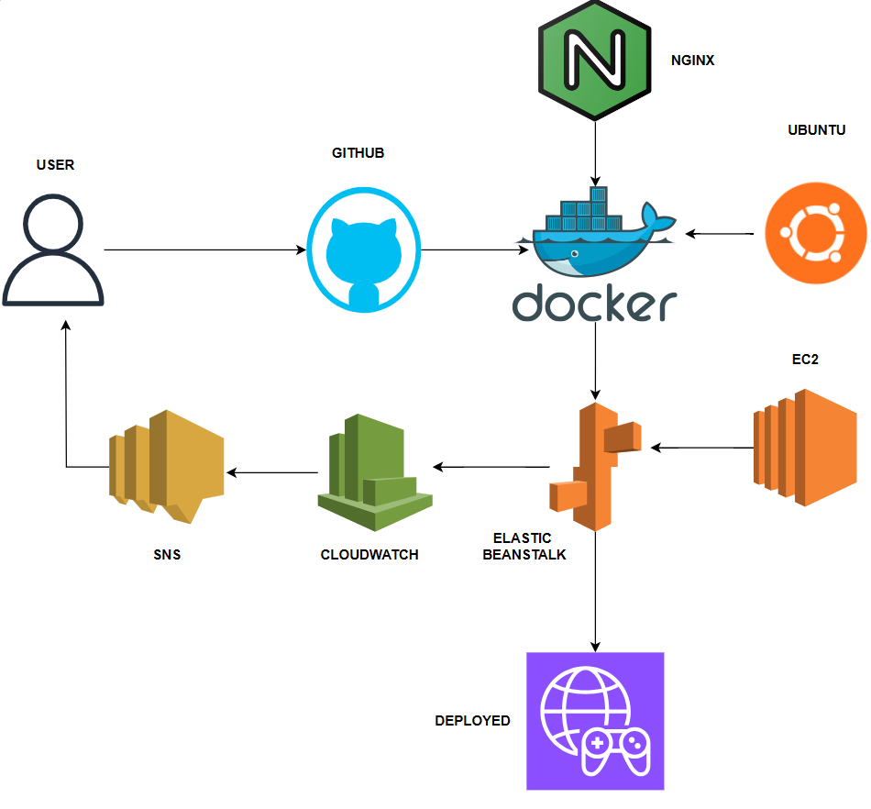
ARCHITECTURE
TECH STACK
Enter your diagram here
Docker
Ubuntu 22.04 (Base OS for Docker container)
Nginx (Web server)
GitHub (Source code repository)
AWS Elastic Beanstalk (Platform for deployment)
Amazon EC2 (Compute instances)
AWS CloudWatch(Monitoring)
AWS SNS(Alerting)

Slide 6
USE CASE
Education and Training: Creating interactive learning experiences or simulations that need reliable performance and secure access.
Marketing and Advertising: Running interactive campaigns or promotions that require high-performance and cost-effective hosting.
Research and Development: Conducting simulations or experiments that need powerful and scalable computing resources.
Gaming Industry: Deploying multiplayer or online games that require scalability, security, and cost-effective resource management.
Entertainment: Hosting virtual events, concerts, or exhibitions that demand scalable and secure infrastructure.

Slide 7
CONCLUSION
In conclusion, deploying a containerized Docker game on AWS Cloud presents a robust solution for various industries, including gaming, education, entertainment, marketing, and research. By optimizing resources, implementing security measures, ensuring scalability, configuring networking, and utilizing monitoring and automation, organizations can create immersive and engaging experiences for their audiences. Additionally, backup strategies, cost management, compliance with regulations, and performance optimization are critical aspects to consider for a successful deployment. Overall, leveraging AWS Cloud for hosting containerized games opens up new possibilities for innovation and engagement across industries.

